Slide 1
Windows Process Injection
Demonstrated on LockDownBrowser

Slide 2
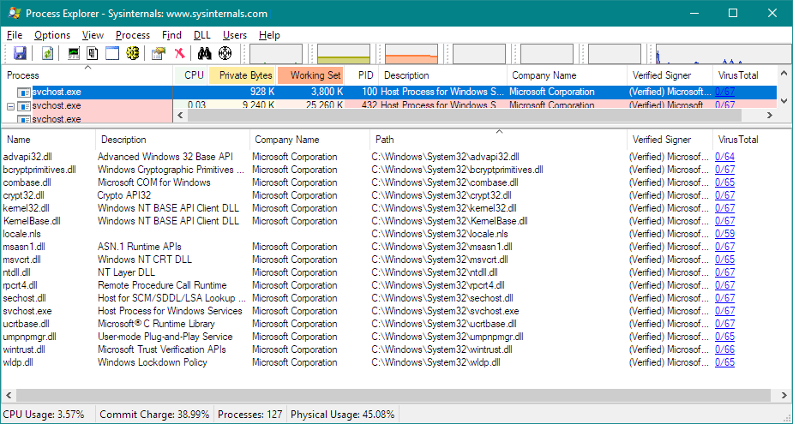
Preface – “Windows Process”

Slide 3
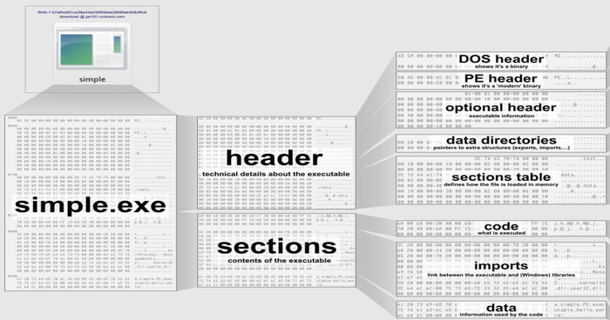
”PE” File makeup

Slide 4
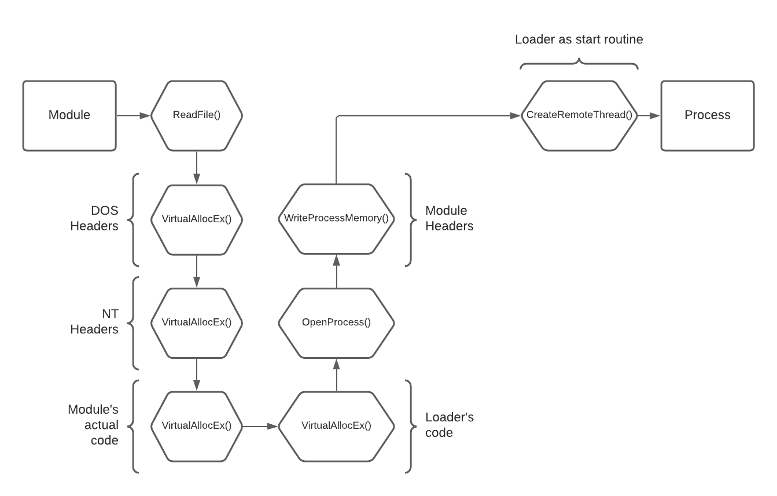
Preface – module INjection
Usually, two methods

Slide 5
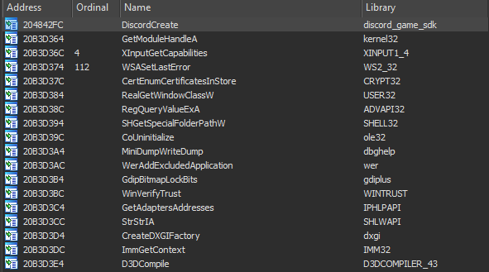
One more method
Only works in executables that ship with a library

Slide 6
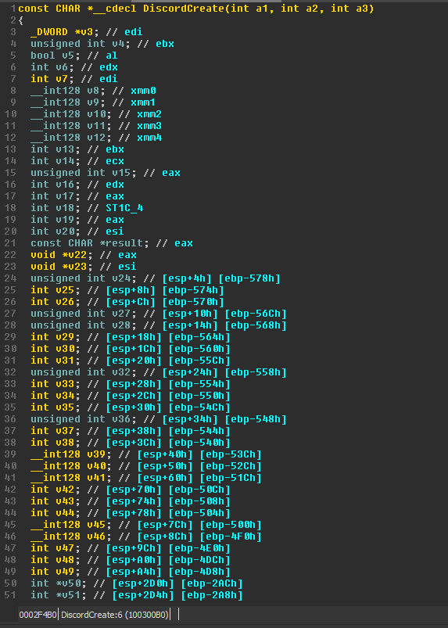
Looking further
DiscordCreate() function under the hood

Slide 7
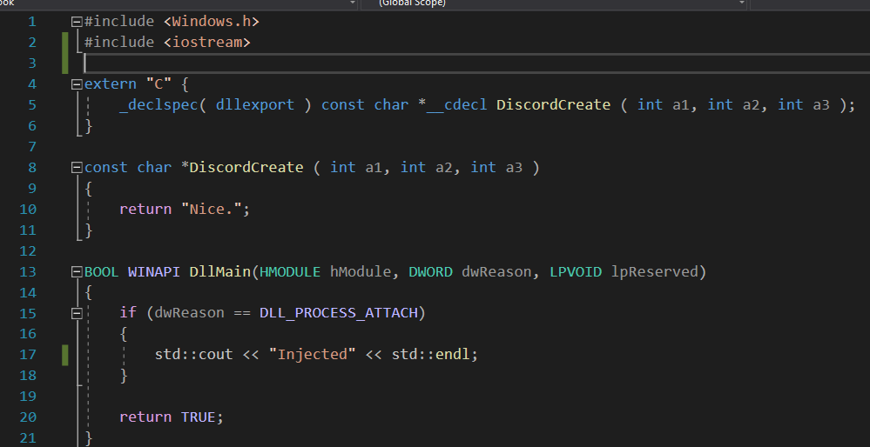

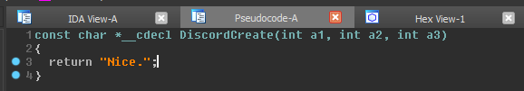
Fake export
We exported our own function called DiscordCreate() and return any const char*

Slide 8
Does this work?
Yes! A few drawbacks however:
Hash checking
Proper error handling
Replacing a required function*
The best quality if viable?
Completely undetectable

Slide 9
Lockdown browser specific
What is LockDown Browser comprised of?
Heavily modified Chromium
Tons of WINAPI function calls to disable potential bypasses (Task Manager, CMD, changing user level, etc.)
Few of low-level hardware & software hooking (what we are interested in)

Slide 10
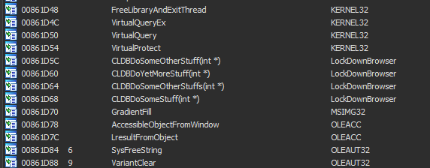
Lockdown browser imports
OwO what’s this?

Slide 11
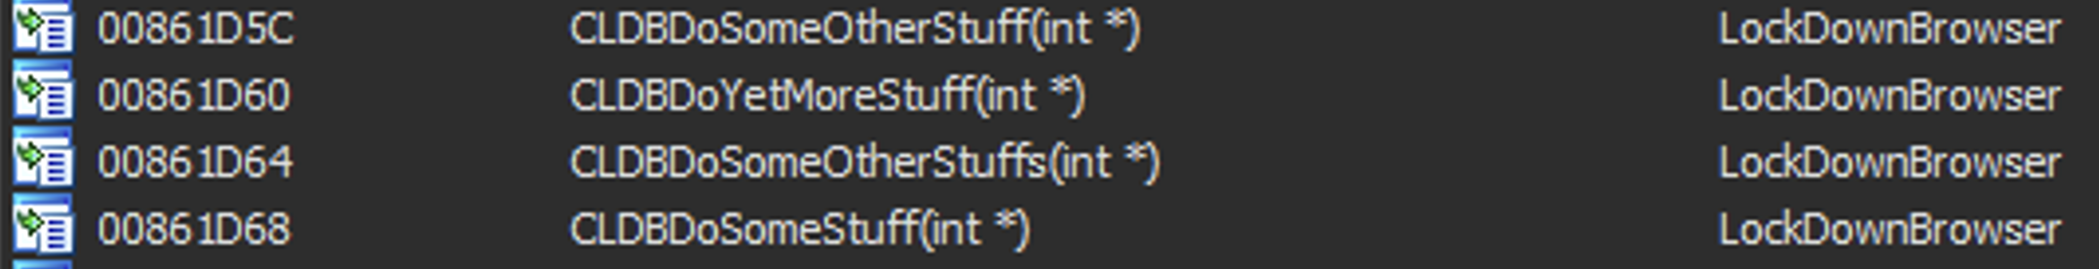
Strange function names?
Address*
Function Name
Module Name

Slide 12
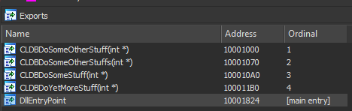
Export & Import relationship
We have seen imported functions inside LockDownBrowser.exe
What does the exported side look like in LockDownBrowser.dll?
LockDownBrowser.dll export table

Slide 13
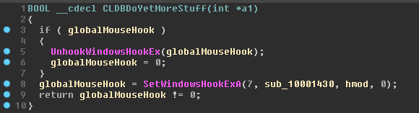
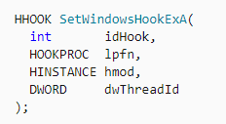
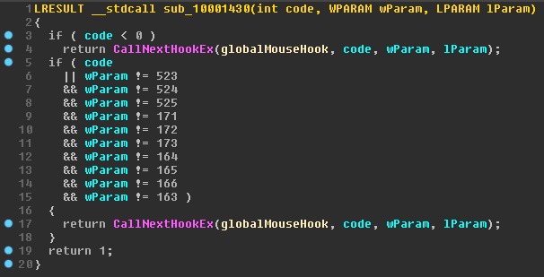
Comparing function disassembly
1

Slide 14
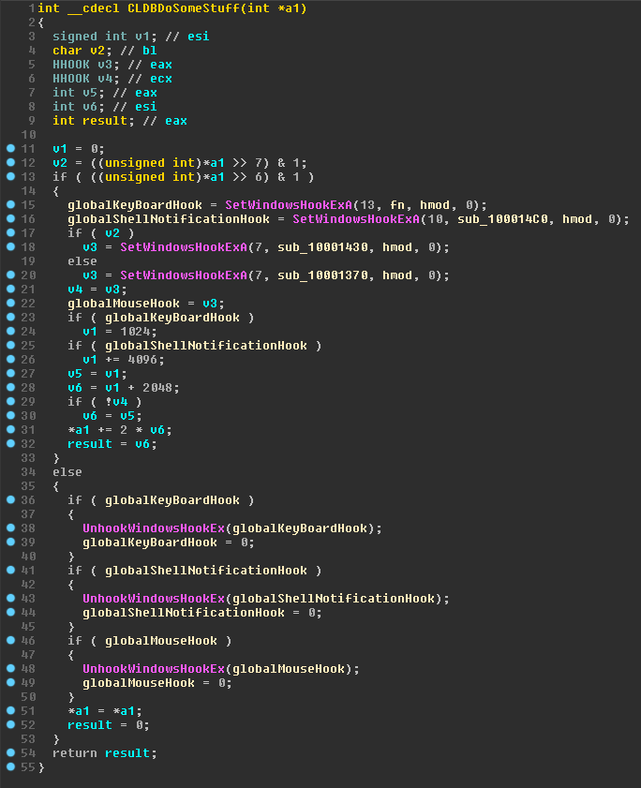
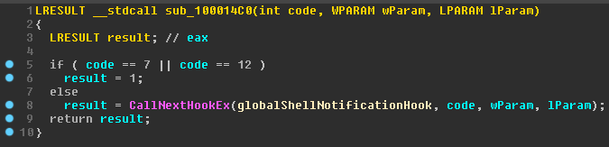
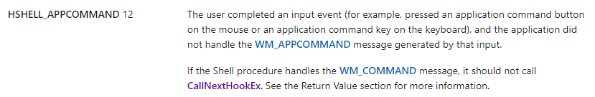
Comparing function disassembly
2

Slide 15
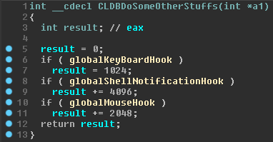
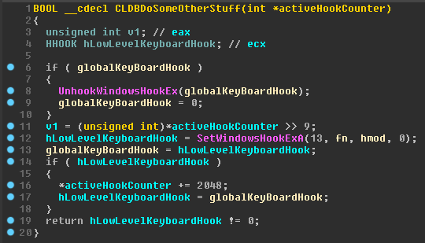
Comparing function disassembly
3

Slide 16
